Slide 1
Milk Tea Mini Shop Management
Class Name: PF08
Group Name: Group_2
Member: Nông Hồng Cương
Nguyễn Long Nhật

Slide 2
Objectives
Build a console app to help user manage our shop more conveniently.

Slide 3
Customer Requirements
Have basic functions such as:
  Login.
  Insert new drink into system.
  Update unit price of existed drinks.
  Create order and print out invoices.
  Update order.

Slide 4
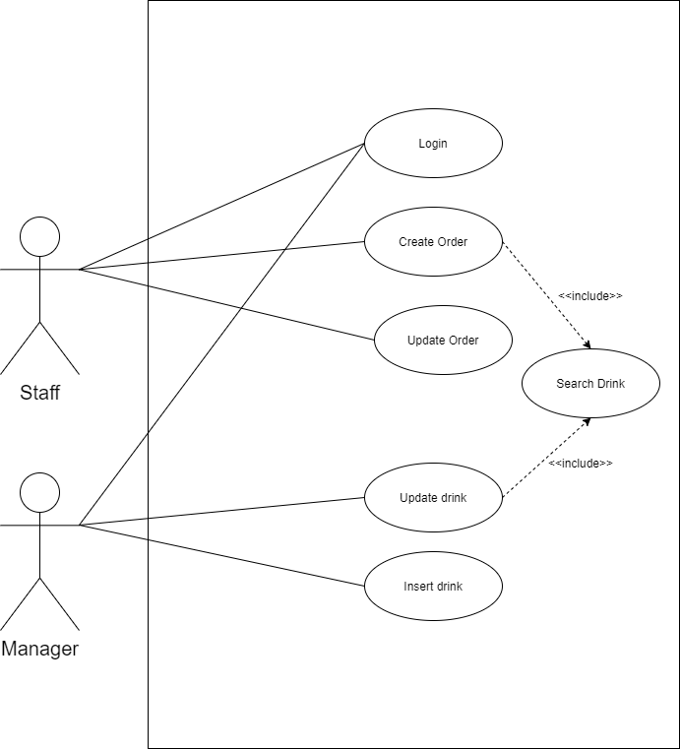
Use Case

Slide 5
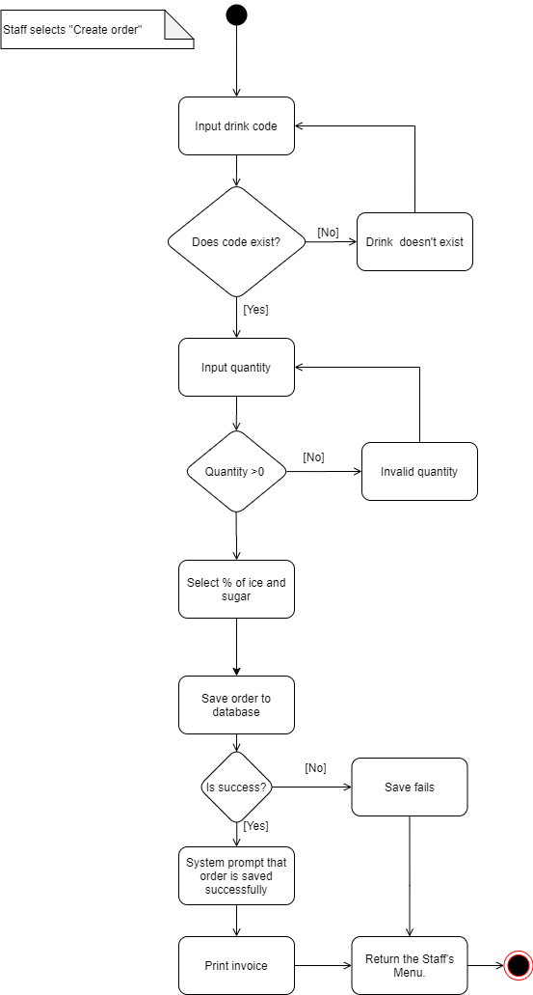
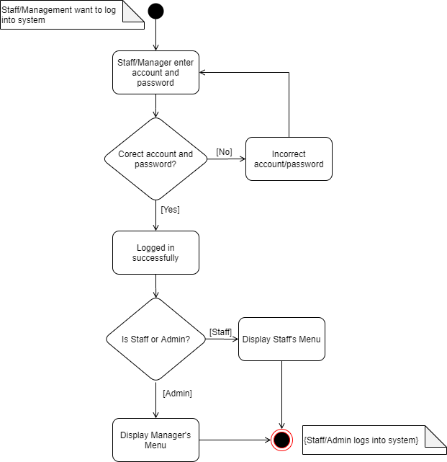
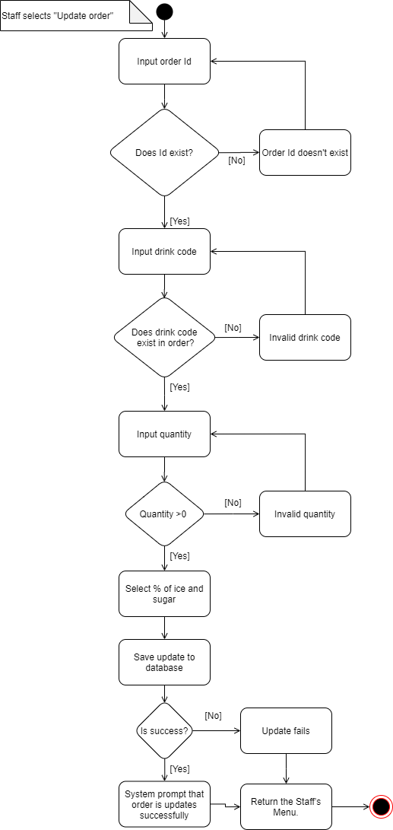
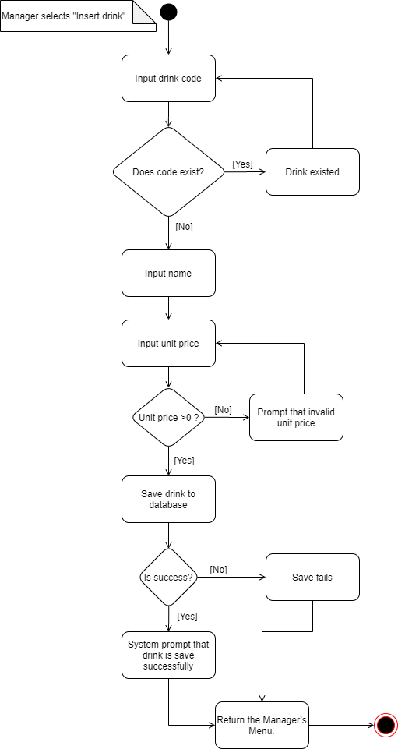
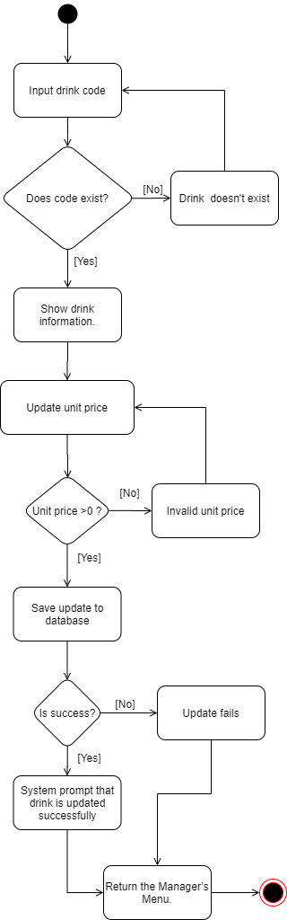
Activity Diagram

Slide 6
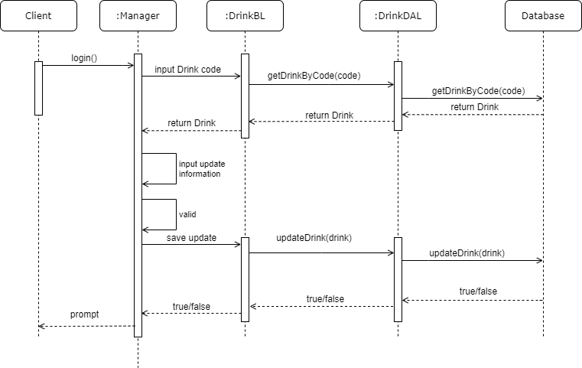
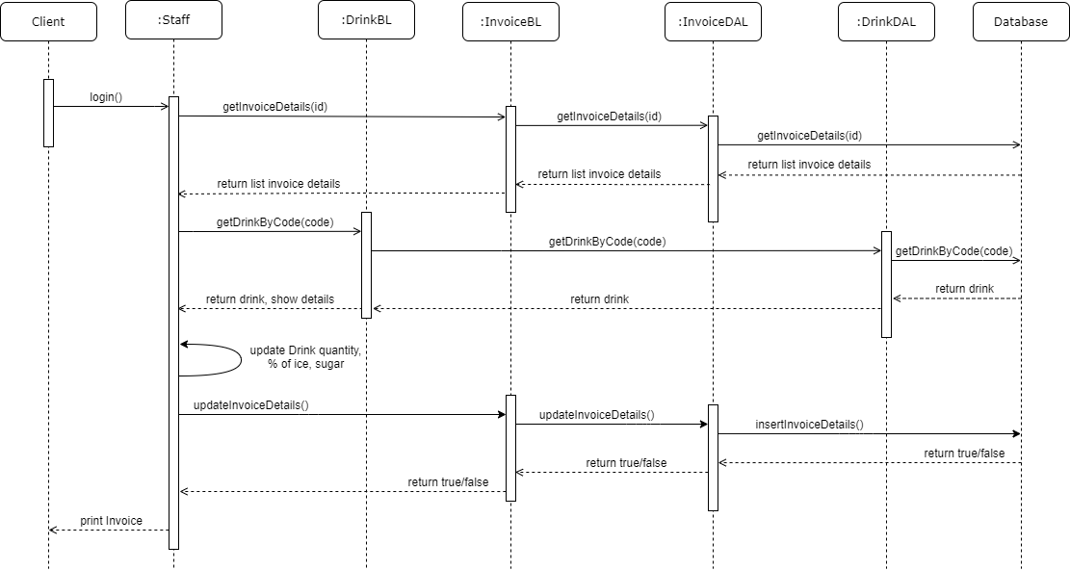
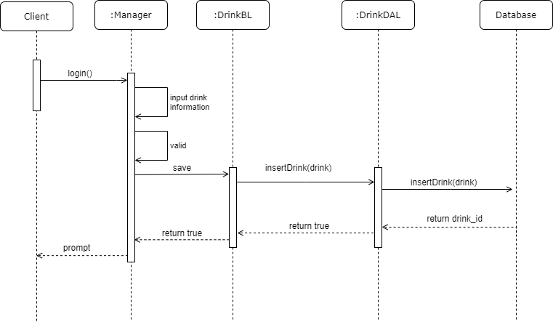
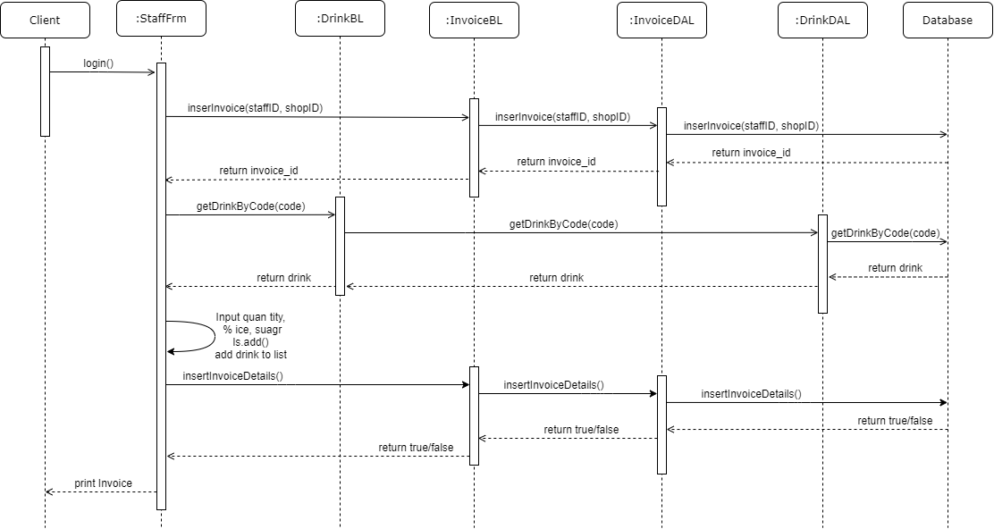
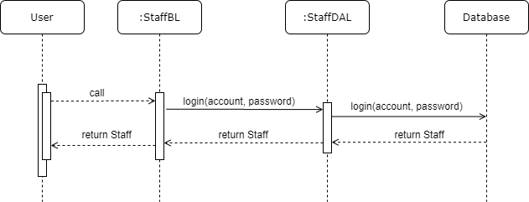
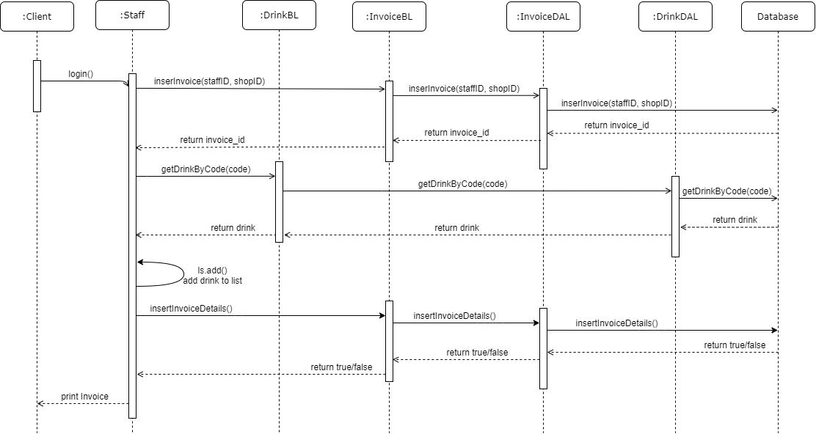
Sequence Diagram

Slide 7
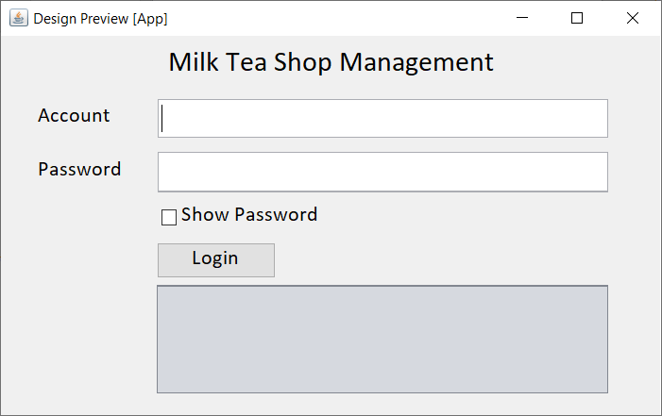
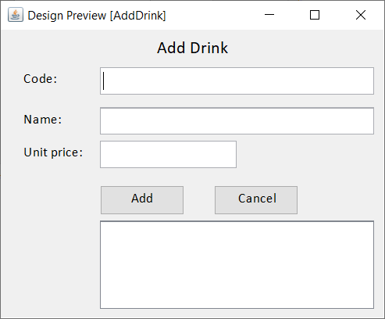
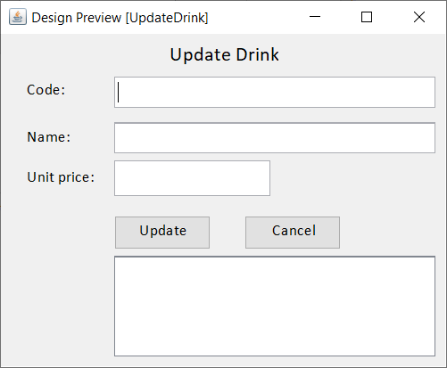
UI Design

Slide 8
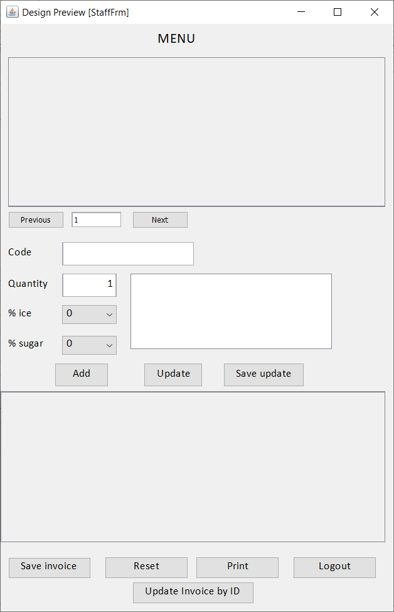
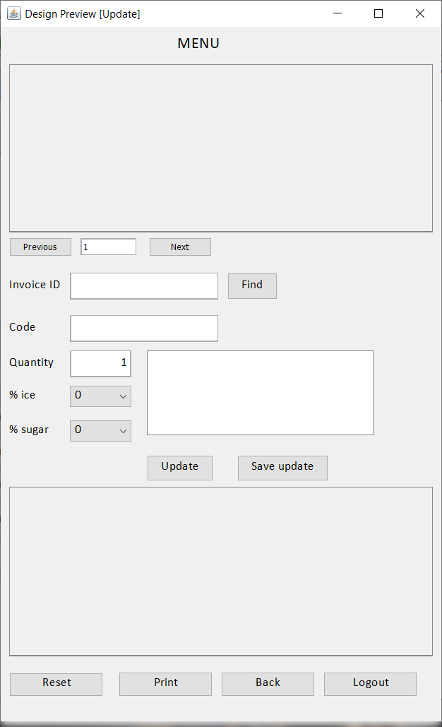
UI Design

Slide 9
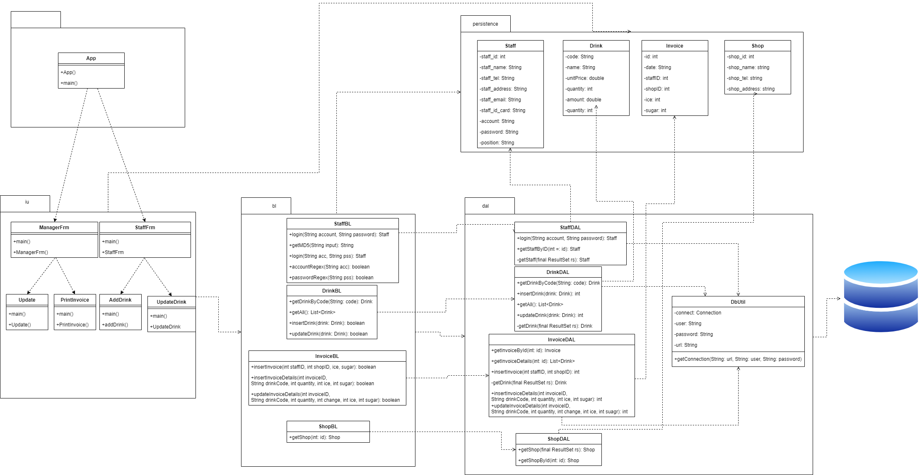
Class Diagram

Slide 10
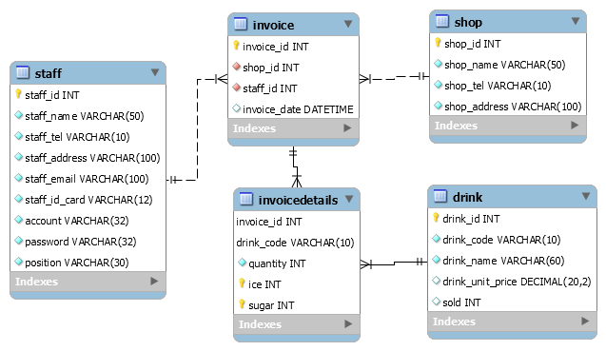
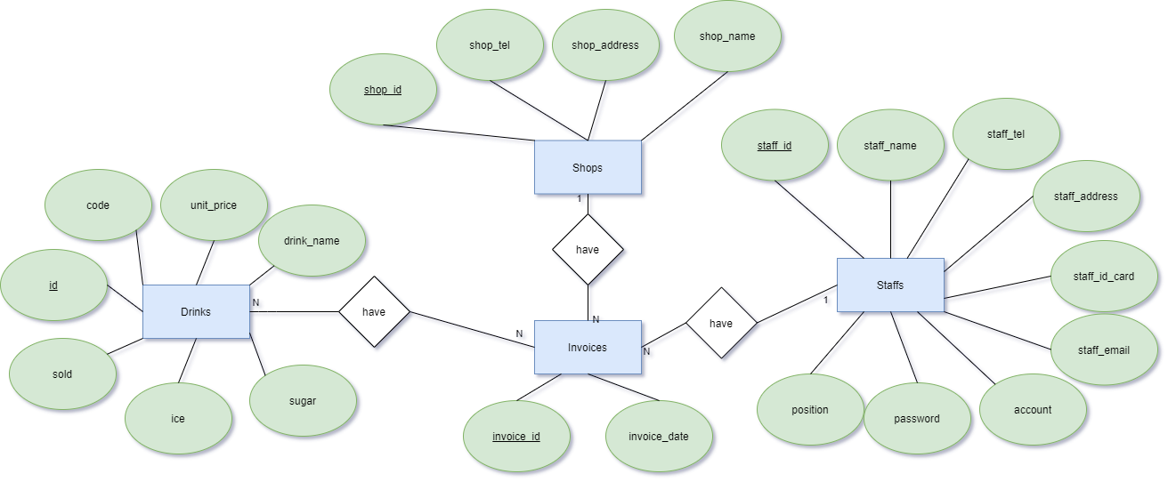
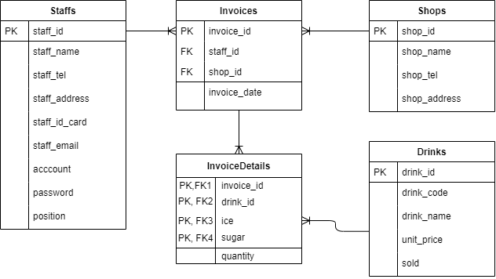
Entity Relationship Diagram

Slide 11
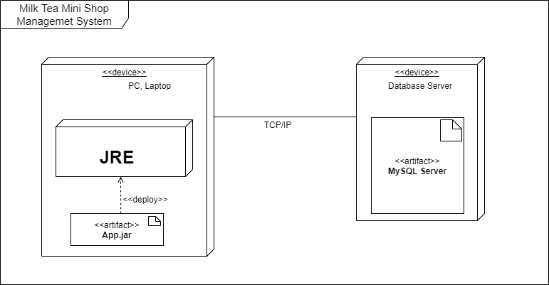
Deployment Diagram

Slide 12
Assign work to each team member
7 | Design sequence diagram | Design sequence diagrams for the system's workflow for each use case | 01/08/2020 | 28/08/2020 | Nông Hồng Cương, Nguyễn Long Nhật
8 | Design class diagram | Design sequence diagrams for the system | 05/08/2020 | 30/08/2020 | Nông Hồng Cương, Nguyễn Long Nhật | Cương: persistance, bl. Nhật: ui, dal
9 | Coding | Write code base on class diagram | 15/08/2020 | 01/09/2020 | Nông Hồng Cương, Nguyễn Long Nhật
10 | Update code | Fix errors, update features | 25/08/2020 | 07/09/2020 | Nguyễn Long Nhật
11 | Deployment digram | Draw deployment digram | 01/08/2020 | 01/09/2020 | Nông Hồng Cương
12 | Complete document |  | 01/09/2020 |  | Nông Hồng Cương
Group 2 | Milk Tea Mini Shop Management
No | Task name | Description | Start Date | End Date | Member | Self assessment
1 | System design | System model archtecture | 25/07/2020 |  | Nguyễn Long Nhật
2 | Use case design | Design system | 30/07/2020 |  | Nông Hồng Cương, Nguyễn Long Nhật
3 | Entity relationships design | Identify the ralationship between entities | 29/07/2020 | 30/07/2020 | Nông Hồng Cương
4 | Design database | Create Database | 01/08/2020 | 07/08/2020 | Nông Hồng Cương, Nguyễn Long Nhật
5 | Use case descriptions | Describe usecases | 01/08/2020 | 08/08/2020 | Nông Hồng Cương, Nguyễn Long Nhật
6 | Design activity diagram | Design the system's task processing flowchart for each use case | 01/08/2020 | 08/08/2020 | Nông Hồng Cương, Nguyễn Long Nhật
13 | Complete slide |  | 01/09/2020 |  | Nông Hồng Cương
14 | Update code | Code UI with Java Fx | 07/09/2020 | 18/09/2020 | Nguyễn Long Nhật
15 | Update database | Change properties | 07/09/2020 | 18/09/20202 | Nông Hồng Cương
16 | Complete document |  | 15/09/2020 |  | Nông Hồng Cương
17 | Complete slide |  | 17/09/2020 |  | Nguyễn Long Nhật

Slide 13


Slide 14
Q & A

